Slide 1
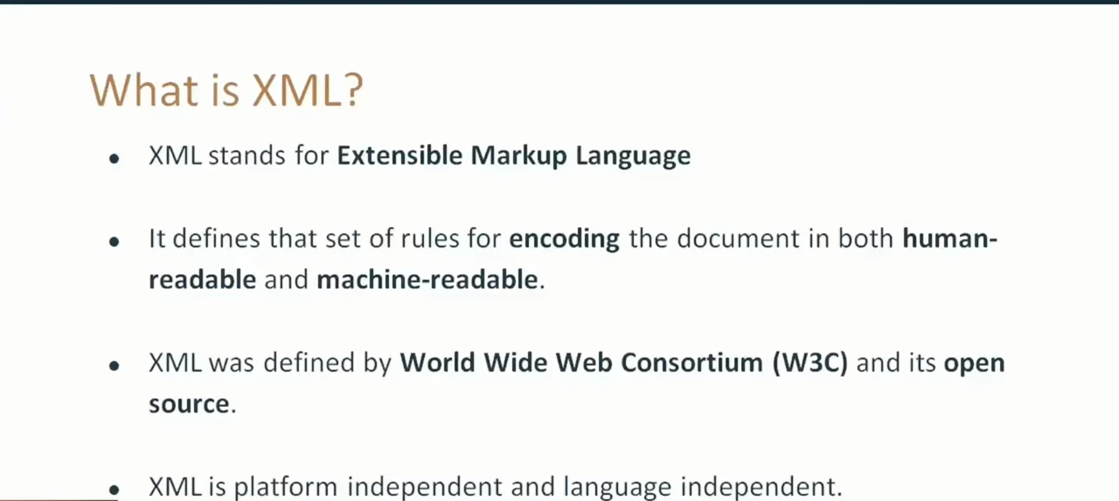

Slide 2
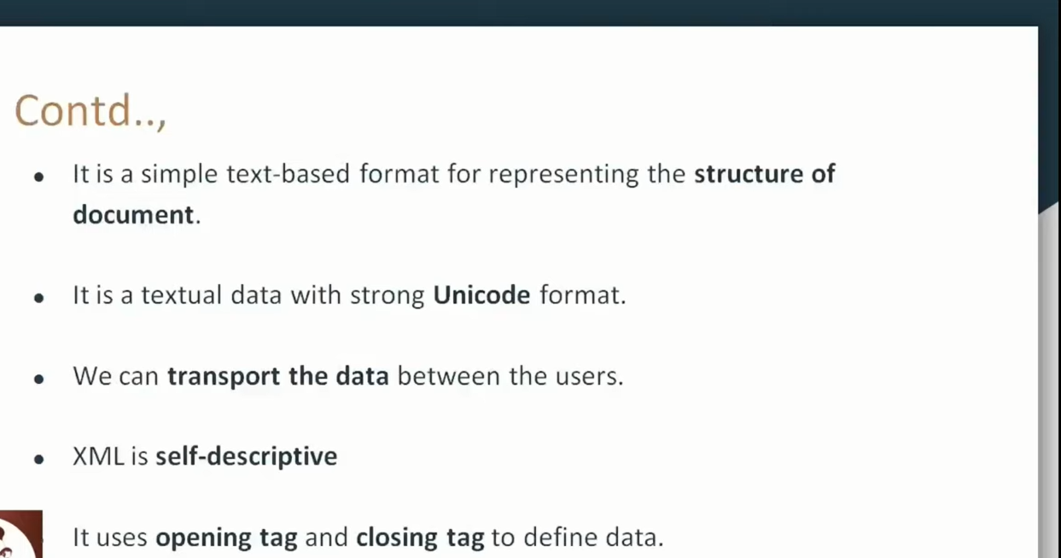

Slide 3
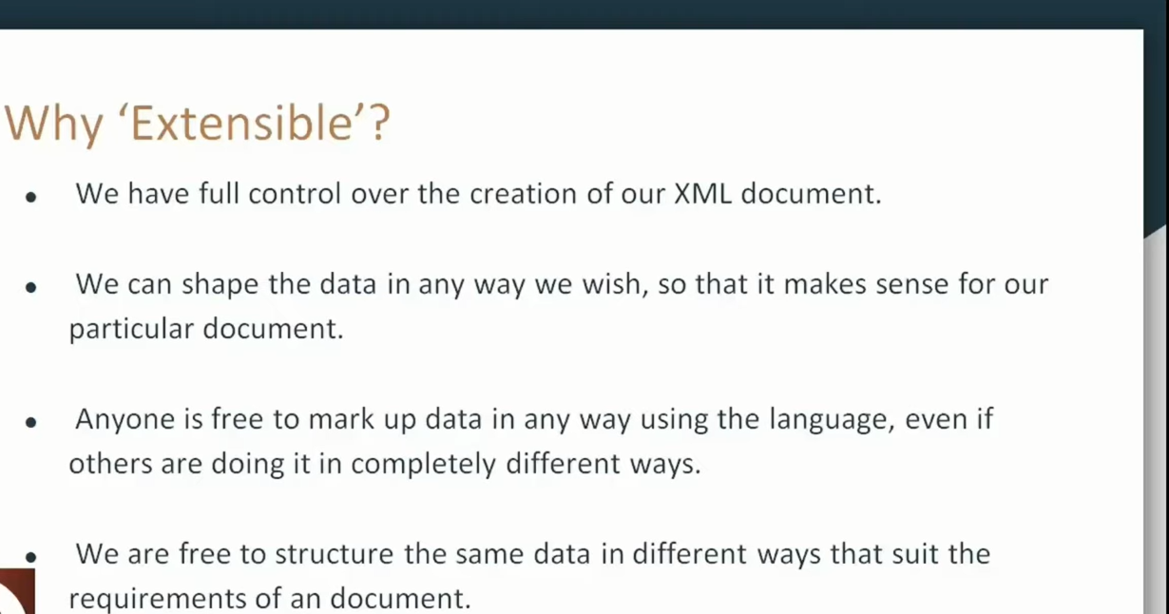

Slide 4
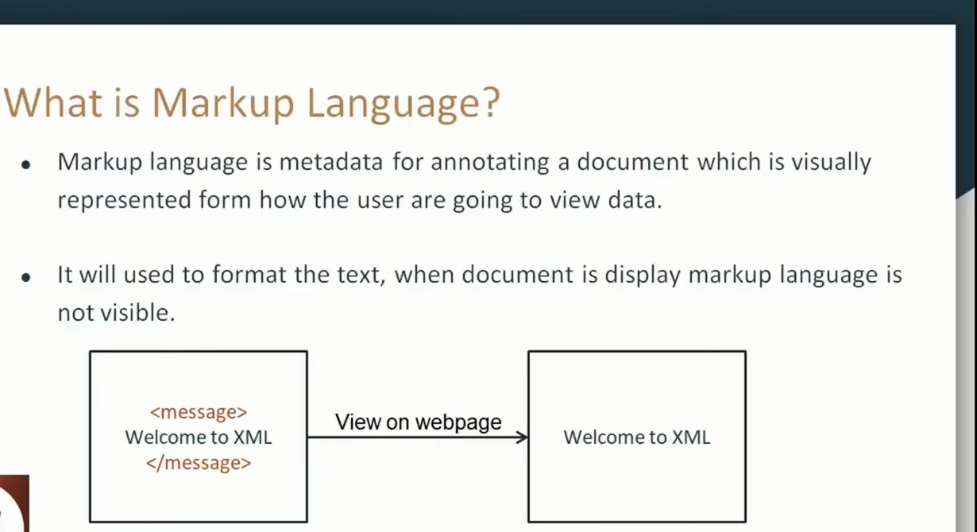

Slide 5
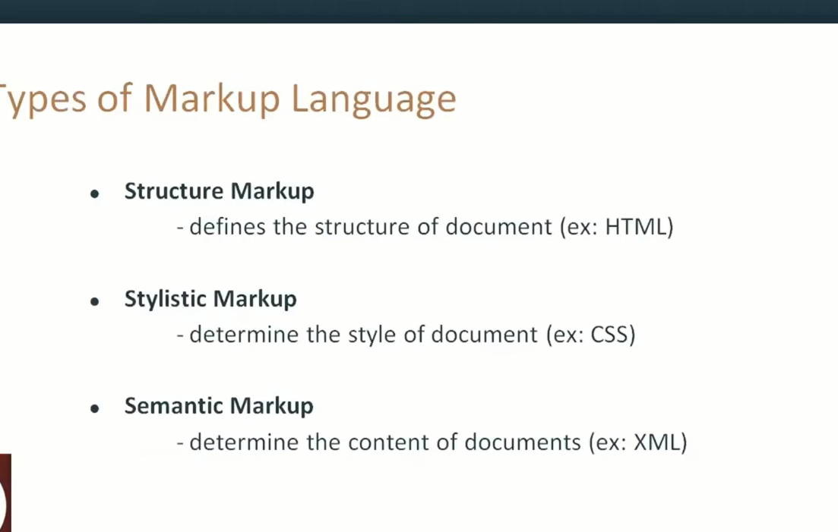


Slide 6
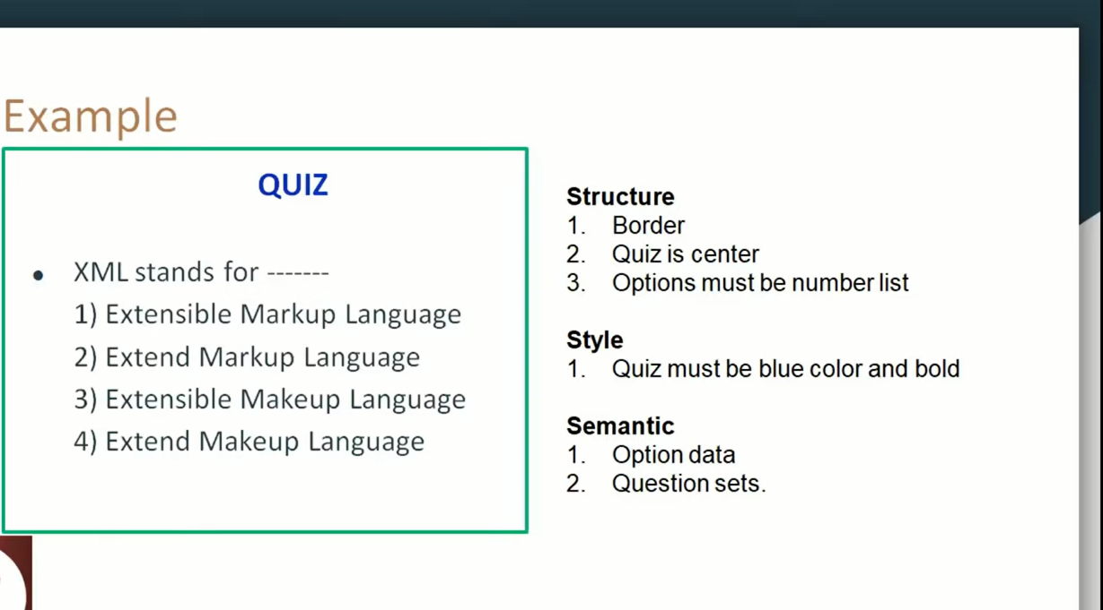

Slide 7
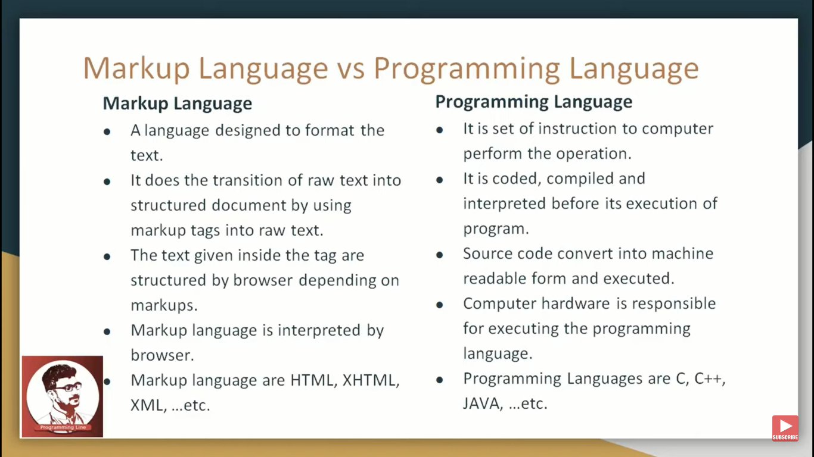

Slide 8
JSON IN JAVA
The json.simple library allows us to read and write JSON data in Java. In other words, we can encode and decode JSON object in java using json.simple library.
Download json-simple.jar
Download the zip file & extract
The org.json.simple package contains important classes for JSON API.
JSONValue
JSONObject
JSONArray
JsonString
JsonNumber

Slide 9
JSONObject
1.create javaproject & class& set the buildpath –configure build path-modulepath-addjarfile-click the json.sample.1.1.jar file-apply and close
Source code
simple example to encode JSON object in java.
package jsonfirst;
import org.json.simple.JSONObject;
public class jsonobj {
public static void main(String args[]){
JSONObject obj=new JSONObject();
obj.put("name","sonoo");
obj.put("age",new Integer(27));
obj.put("salary",new Double(600000));
System.out.print(obj);
}}
Output:{"name":"sonoo","salary":600000.0,"age":27}

Slide 10
simple example to encode JSON array in java
. package jsonfirst;
import org.json.simple.JSONArray;
public class jsonobj {
public static void main(String args[]){
JSONArray arr = new JSONArray();
arr.add("sonoo");
arr.add(new Integer(27));
arr.add(new Double(600000));
System.out.print(arr);
}}
Output:["sonoo",27,600000.0]

